Slide 1
Data Science in NFL Scheduling

Slide 2
Overview of the schedule
There are 32 teams in the NFL.
Each team plays 16 regular season games over 17 weeks with one bye week.
Teams play 8 home and 8 road games during the regular season.

Slide 3
Key rules for the schedule
Six games against divisional opponents — two games per team, one at home and one on the road.
Four games against teams from a division within its conference — two games at home and two on the road.
Four games against teams from a division in the other conference— two games at home and two on the road.
Two games against teams from the two remaining divisions in its own conference — one game at home and one on the road. Matchups are based on division ranking from the previous season.
Each team has one bye week between Weeks 5 and 13.

Slide 4
Key considerations for the schedule
Television scheduling
Holiday dates
Travel
Stadium availability
Competitive equity

Slide 5
How the schedule used to be done
It took 11-12 weeks for a team to put the schedule together by hand.
1 game at a time created.
Linear

Slide 6
How Data Science has transformed the scheduling
5 people 12 weeks for 256 games over 17 weeks.
Combinations are in the quadrillions
More than 50k viable schedules.
Parallel scheduling
Process takes 3 months with computers working 24 hrs a day.

Slide 7
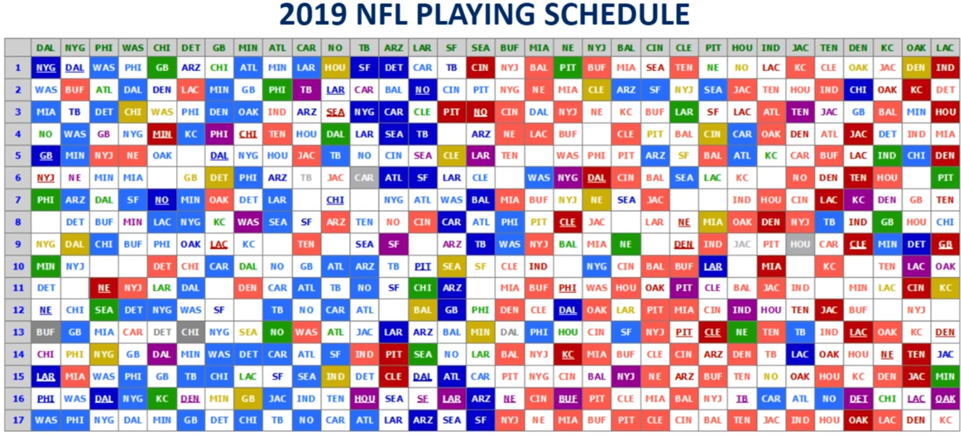
Notes:
Shaded is home
White is road
Empty white boxes are byes
Green NBC
Yellow ESPN
Purple Thursday Night
Blue Fox
Red CBS
Start with 256 games.
Starts with a rotation-–strict started in 2002.
14/16 games are determined by the rotation.
Only 2 games are determined by standings.
70’s/80’s used to be determined by the previous years standings.
256 games and 32 byes to fit into 544 boxes.
Hundreds of trillions of possible schedules

Slide 8
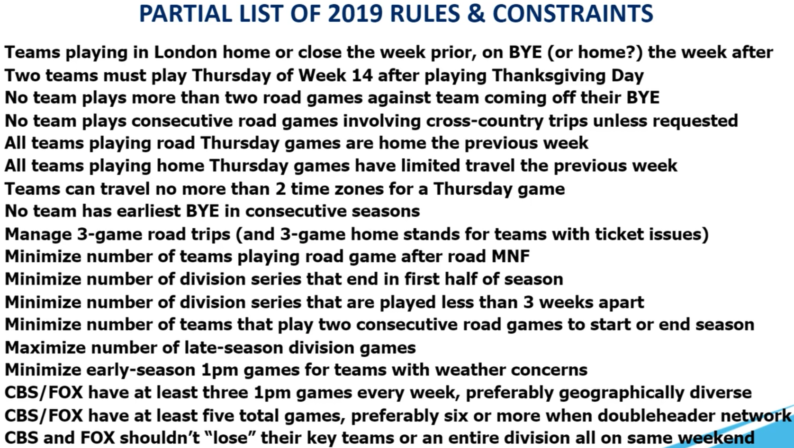

Slide 9
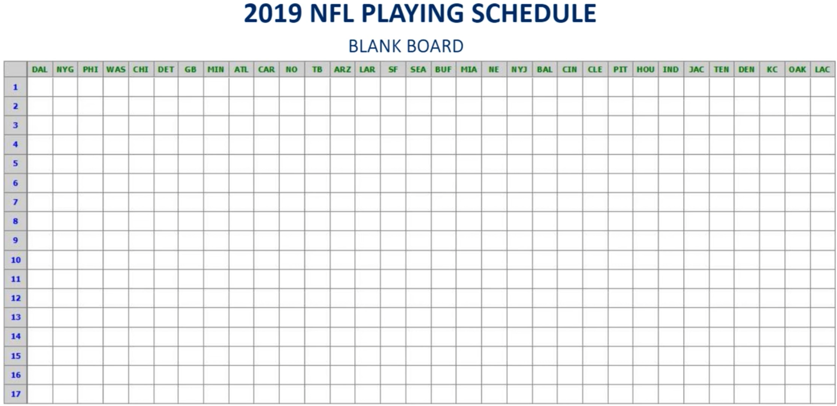

Slide 10
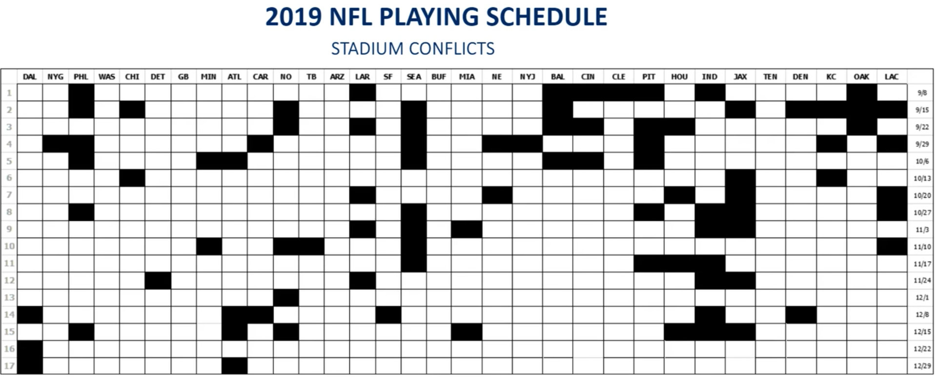

Slide 11
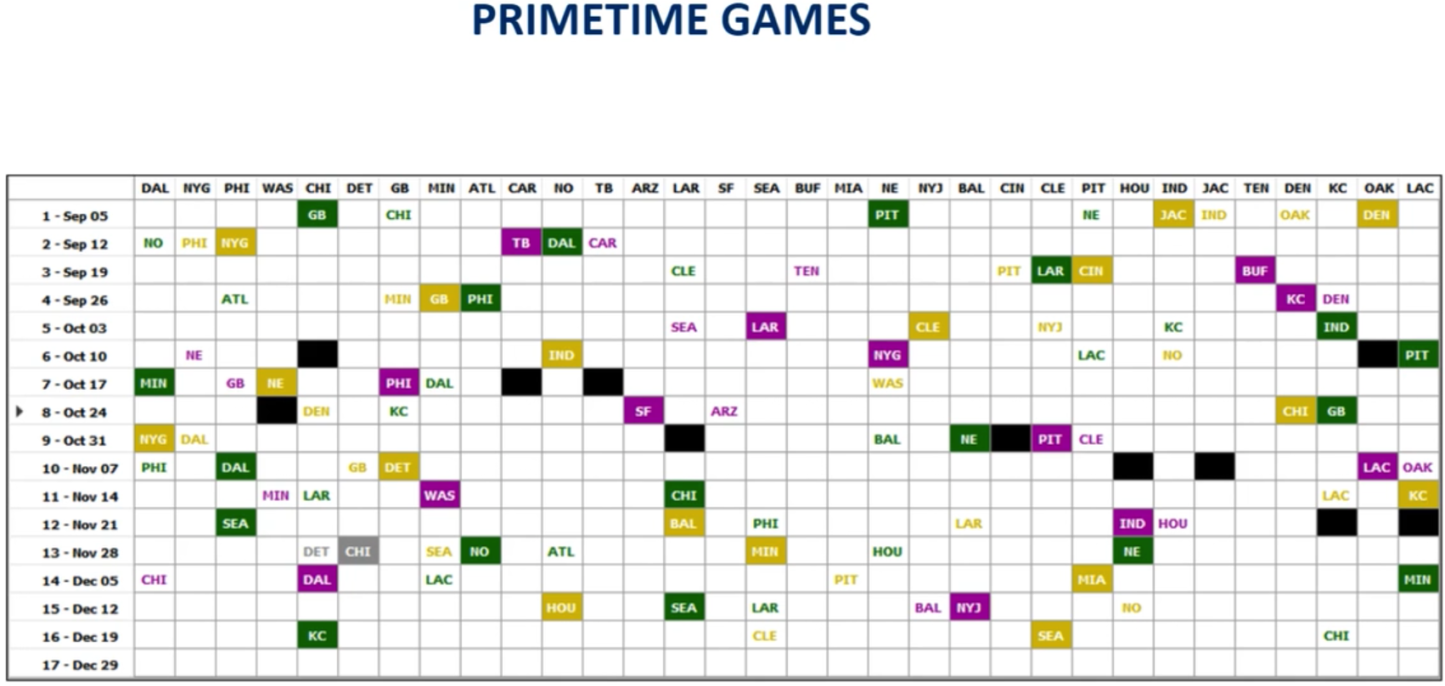
Notes:
This is the seed schedule. They focus first on the primetime games they want to show on the networks. Usually about 50 games and then they start to fill the rest in.
They create multiple seed schedules for key games.

Slide 12
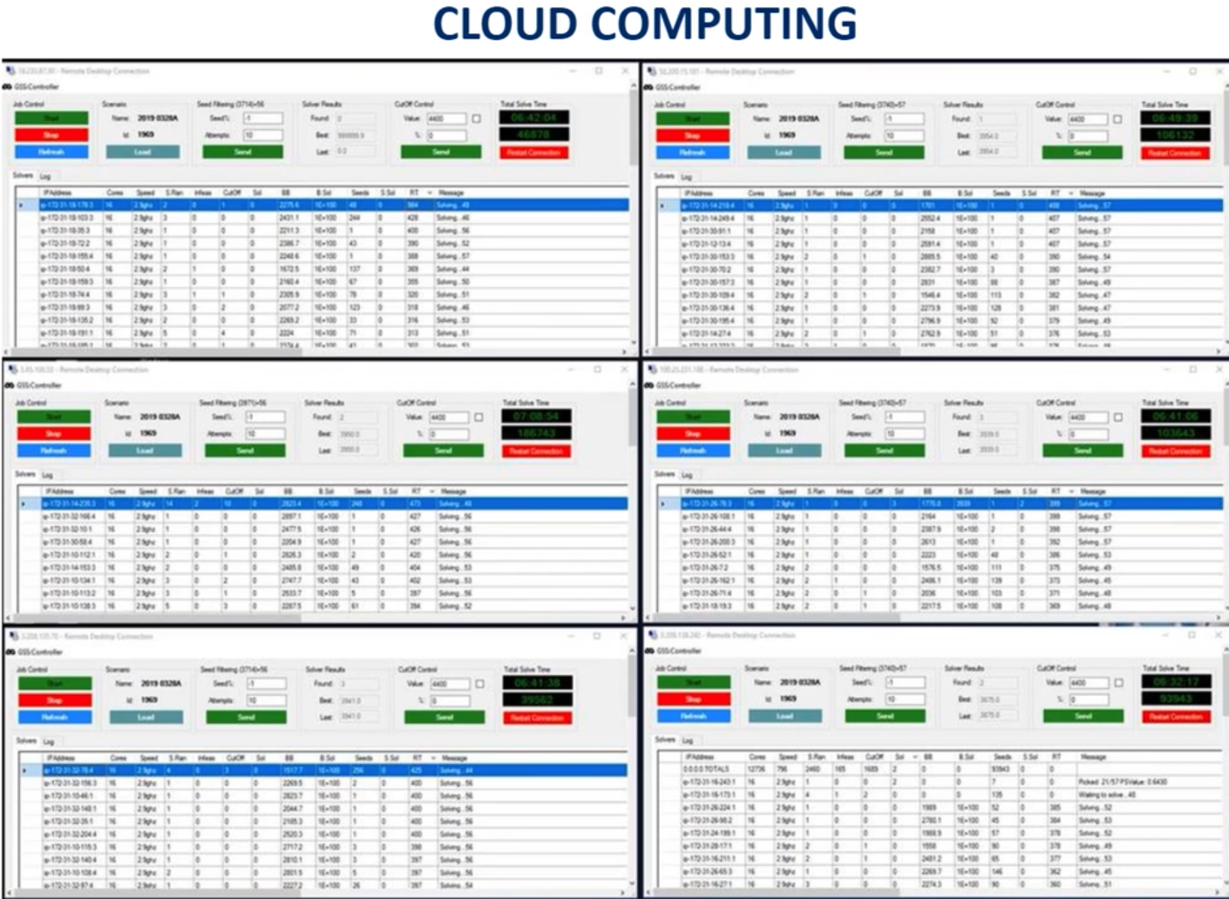
Text
Notes:
They then have different clusters when they analyze different versions of the schedule seeds to find the best schedule.
They use AMAZON AWS to power the analysis. 200-400 servers per cluster.
They use a negative scoring system to see how many rules they break. Lowest score is the best.
They continue to analyze. MORE CONSTRATINTS EVERY DAY TO OPTIMIZE SCHEDULE.
12-18 solve cycle with the clusters.
Then the humans intervene and look at the best.
Then they review and create new rules.
Then repeat this process.
Can be 1M seed schedules that they iterate through to see what problems they are changes.
Computers over night and then humans analyze and create new rules to run again.
May be 12-14 weeks to create schedule.
THEY HAVE THEIR OWN NEGATIVE SCORING SYSTEM TO ANALYZE THE SCH. LOWER IS BETTER. REVENUE IS 2ND WAY THEY LOOK AT IT.

Slide 13
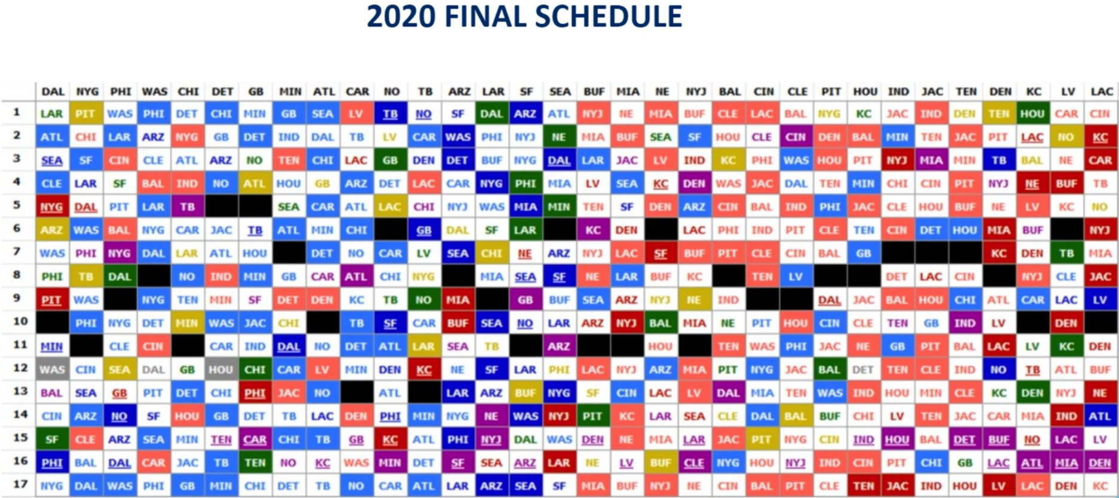

Slide 14
Sources
https://www.cbssports.com/nfl/news/2020-nfl-strength-of-schedule-rankings-ravens-and-steelers-have-it-easiest-patriots-face-roughest-ride/
https://siliconangle.com/2014/05/29/how-the-nfl-optimizes-broadcast-schedules-with-ibm-hardware-ibmedge/
https://operations.nfl.com/the-game/creating-the-nfl-schedule/
https://www.datasciencecentral.com/video/dsc-webinar-series-optimization-and-the-nfl-s-toughest-scheduling
Notes:
What is optimal?
Setting rules to make penalties are appropriate.
Not just software and optimization but also with hardware.

